Slide 1
zekeLabs
Learning made Simpler ! www.zekeLabs.com

Slide 2
Docker Swarm

Slide 3
What is Swarm
A swarm consists of one or more nodes: physical or virtual machines running Docker Engine.
It was introduced first under Docker 1.12 release.
It enables the ability to deploy containers across multiple Docker hosts, using overlay networks for service discovery with a built-in load balancer for scaling the services.

Slide 4
What is Swarm
A swarm consists of multiple Docker hosts which run in swarm mode and act a:
1. managers (to manage membership and delegation) and
2. workers (which run swarm services).
A Docker host can be a manager, a worker, or perform both roles.
A task is a running container which is part of a swarm service and managed by a swarm manager

Slide 5
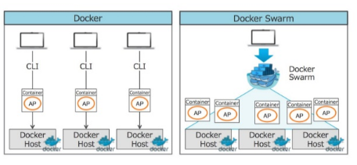
Docker vs Docker Swarm

Slide 6
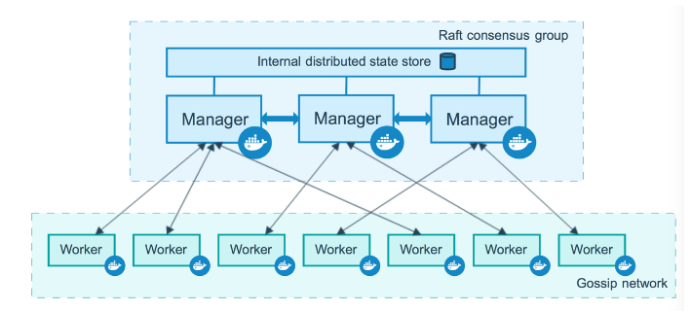
How Nodes work?

Slide 7
Why Swarm?
You can modify a service’s configuration, including the networks and volumes it is connected to, without the need to manually restart the service.
When Docker is running in swarm mode, you can still run standalone containers on any of the Docker hosts participating in the swarm, as well as swarm services.

Slide 8

What is Swarm
Orchestration Components
Swarm Mode Manager
Swarm Mode Worker
MacVLAN
Support
Service Discovery
Networking
Secrets Management
TLS
Certificate Authority
Volumes
Service Rollbacks
Scheduling/
Placements
Load Balancing
Plugins
Distributed store
High Availability Scheduling
Topology Aware Scheduling
Service Logs
Health-Aware
Orchestration
Container Runtime
8

Slide 9
Swarm Features
Cluster management integrated with Docker Engine
Decentralized design
Declarative service model
Scaling
Desired state reconciliation
Multi-host networking
Service discovery
Load balancing
Secure by default
Rolling updates

Slide 10
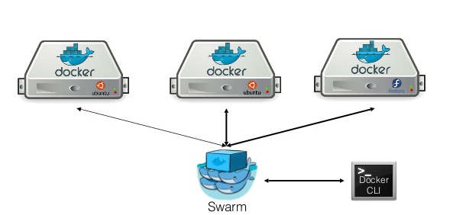
Swarm

Slide 11
Swarm constructs: Nodes
A node is an instance of the Docker engine participating in the swarm.
You can run one or more nodes on a single physical computer or cloud server, but production swarm deployments typically include Docker nodes distributed across multiple physical and cloud machines.
To deploy your application to a swarm, you submit a service definition to a manager node.

Slide 12
Swarm constructs: Nodes
The manager node dispatches units of work called tasks to worker nodes.
Worker nodes receive and execute tasks dispatched from manager nodes.
An agent runs on each worker node and reports on the tasks assigned to it.

Slide 13
How Nodes work?

Slide 14
Manager Nodes
Manager nodes handle cluster management tasks:
maintaining cluster state
scheduling services
serving swarm mode HTTP API endpoints
Using a Raft implementation, the managers maintain a consistent internal state of the entire swarm and all the services running on it.
Docker recommends a maximum of seven manager nodes for a swarm.

Slide 15
Worker Nodes
Worker nodes are also instances of Docker Engine whose sole purpose is to execute containers.
Worker nodes don’t participate in the Raft distributed state, make scheduling decisions, or serve the swarm mode HTTP API.

Slide 16
Worker Nodes
You can create a swarm of one manager node, but you cannot have a worker node without at least one manager node.
In a single manager node cluster, you can run commands like docker service create and the scheduler places all tasks on the local Engine.

Slide 17
Change Roles
You can promote a worker node to be a manager by running docker node promote.
For example, you may want to promote a worker node when you take a manager node offline for maintenance.

Slide 18
Swarm constructs: Services and Tasks
A service is the definition of the tasks to execute on the manager or worker nodes.
It is the central structure of the swarm system and the primary root of user interaction with the swarm.

Slide 19
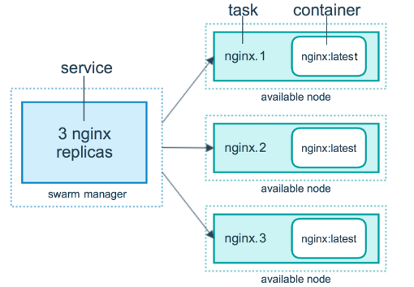
Swarm constructs: Services and Tasks

Slide 20
Building a Swarm
$docker swarm join –token-id <token> <manager node>:2377
@node1
@manager
$docker swarm join-token worker/manager

Slide 21
Building a Swarm
@node3
$docker swarm join –token-id <token> <manager node>:2377
@node1
@node2
@manager
$docker swarm join-token worker/manager
$docker node ls

Slide 22
Swarm constructs: Services and Tasks
In the replicated services model, the swarm manager distributes a specific number of replica tasks among the nodes based upon the scale you set in the desired state.
For global services, the swarm runs one task for the service on every available node in the cluster.
A task carries a Docker container and the commands to run inside the container.

Slide 23
Swarm constructs: Load Balancing
The swarm manager uses ingress load balancing to expose the services you want to make available externally to the swarm.
The swarm manager can automatically assign the service a PublishedPort or you can configure a PublishedPort for the service.
The swarm manager uses internal load balancing to distribute requests among services within the cluster based upon the DNS name of the service.

Slide 24
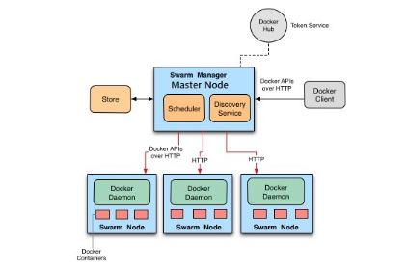
Swarm Mode Architecture

Slide 25
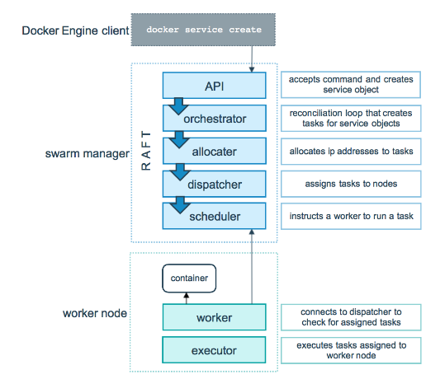
Tasks and Scheduling

Slide 26
Pending Services
A service may be configured in such a way that no node currently in the swarm can run its tasks. In this case, the service remains in state pending
Examples:
If all nodes are paused or drained, and you create a service, it is pending until a node becomes available.
If no node in the swarm has the required amount of memory, the service remains in a pending state until a node is available which can run its tasks.

Slide 27
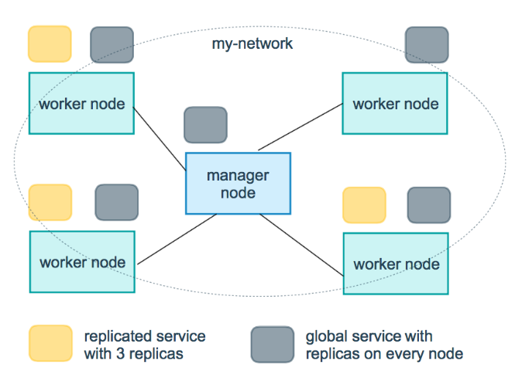
Replicated and Global Services

Slide 28
Replicated and Global Services
For a replicated service, you specify the number of identical tasks you want to run.
A global service is a service that runs one task on every node

Slide 29
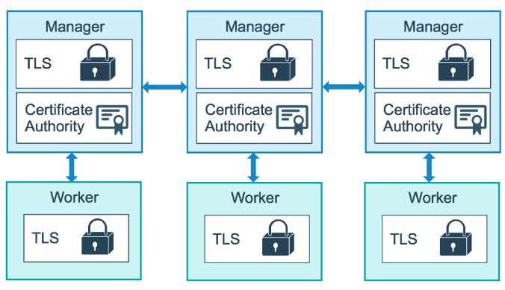
Manage swarm security with public key infrastructure (PKI)

Slide 30
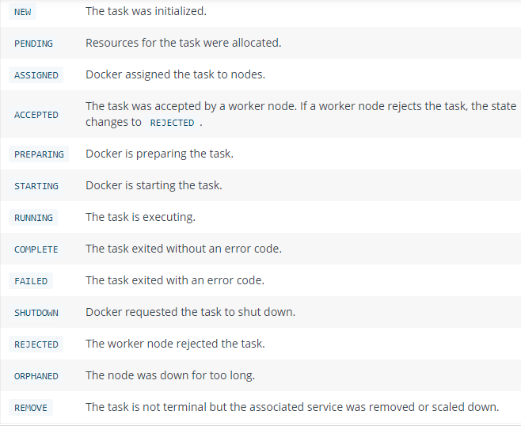
Swarm Task States

Slide 31
Docker Security
The swarm mode public key infrastructure (PKI) system built into Docker makes it simple to securely deploy a container orchestration system.
The nodes in a swarm use mutual Transport Layer Security (TLS) to authenticate, authorize, and encrypt the communications with other nodes in the swarm.

Slide 32
Docker Security
The manager node generates two tokens to use when you join additional nodes to the swarm: one worker token and one manager token.
Each token includes the digest of the root CA’s certificate and a randomly generated secret.
Each time a new node joins the swarm, the manager issues a certificate to the node.

Slide 33
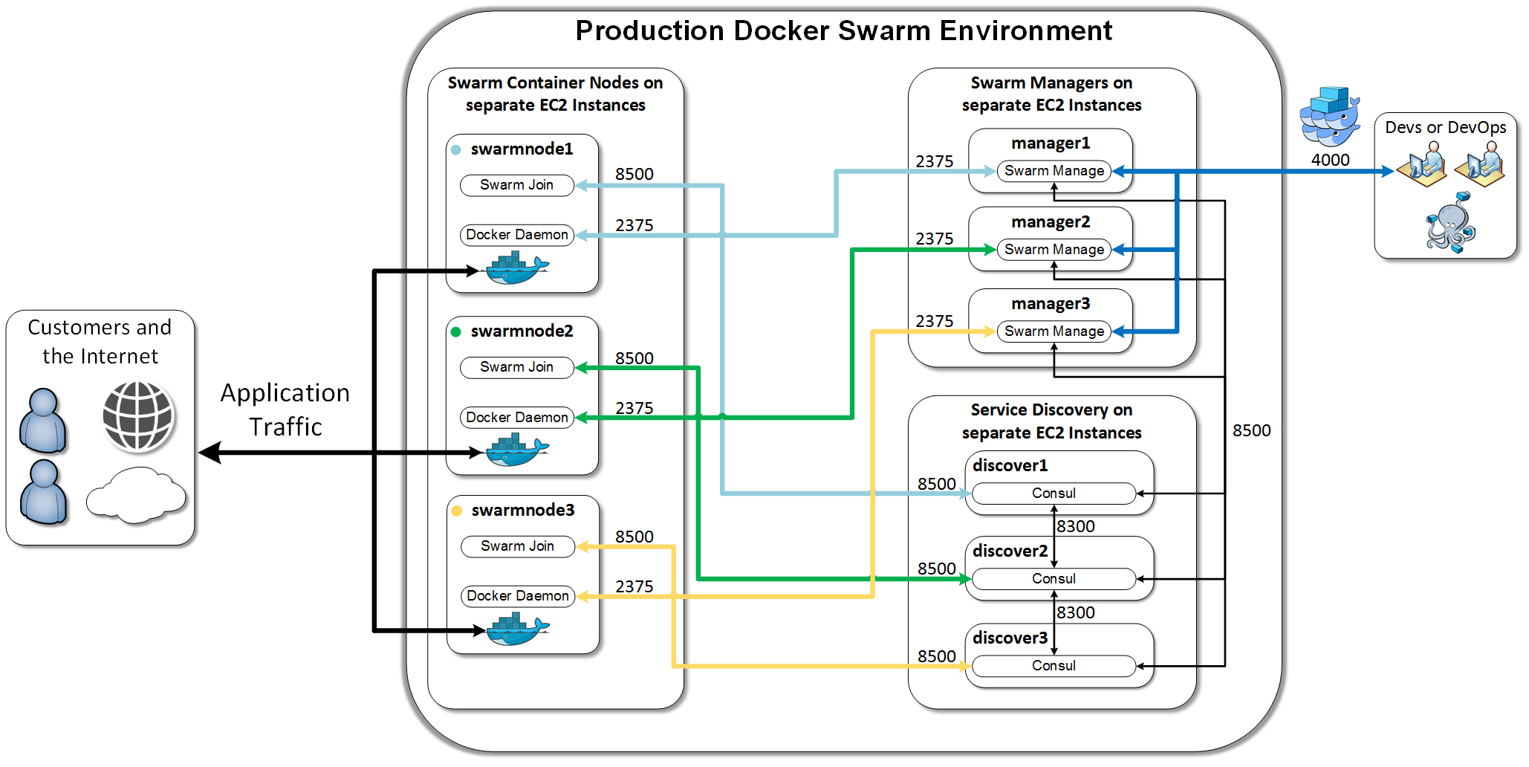
Docker Ecosystem

Slide 34
Docker Swarm lab

Slide 35
Docker Swarm Commands
Command | Description
docker swarm ca | Display and rotate the root CA
docker swarm init | Initialize a swarm
docker swarm join | Join a swarm as a node and/or manager
docker swarm join-token | Manage join tokens
docker swarm leave | Leave the swarm
docker swarm unlock | Unlock swarm
docker swarm unlock-key | Manage the unlock key
docker swarm update | Update the swarm

Slide 36
THANK YOU
Let us know how can we help your organization to Upskill the employees to stay updated in the ever-evolving IT Industry.
Get in touch:
www.zekeLabs.com | +91-8095465880 | info@zekeLabs.com
Visit : www.zekeLabs.com for more details

